Slide 1
APTITUDE
DATA INTERPRETATION
(MISSING NUMBER TYPE)

Slide 2
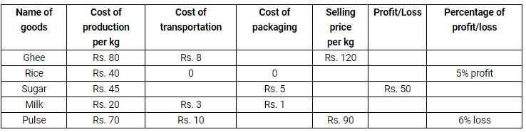
APTITUDE
DATA INTERPRETATION VIDEO-1
Directions (Q. 1-5): Study the table carefully to answer the following questions.
(II) A few values are missing in the table (indicated –). A candidate is expected to calculate the missing value, if it is required to answer the given question, on the basis of the given data and information.

Slide 3
APTITUDE
DATA INTERPRETATION VIDEO-1
Q:1. If the percentage of profit on sold Ghee is 10%, then what is its cost of packaging?
Rs. 24.90 b) Rs. 23.50 c) Rs. 22 d) Rs. 21.09 e) Rs. 27.80
Q:2.What is the difference between the selling price of Sugar and that of Rice, if the cost of transportation is zero for both?
Rs. 56 b) Rs. 52 c) Rs. 58 d) Rs. 36 e) Rs. 72
Q:3.What is the cost of packaging of Pulse?
Rs. 22.5 b) Rs. 20.04 c) Rs. 19.91 d) Rs. 18.71 e) Rs. 15.74
Q:4. What is the percentage profit of Milk if its selling price is 80% of the cost price of Rice?
28% b) 30% c) 32% d) 34% e) 38%
Q:5. 4 kg Ghee, 3 kg Rice and 5 kg Milk are sold. What is Average profit or loss percentage? (The packing cost is zero for all goods) and selling price of Milk is Rs. 32 per kg?
36% b) 32% c) 30.49% d) 34.2% e) none of these

Slide 4
APTITUDE
DATA INTERPRETATION VIDEO-1
Q:1. If the percentage of profit on sold Ghee is 10%, then what is its cost of packaging?
Rs. 24.90 b) Rs. 23.50 c) Rs. 22 d) Rs. 21.09 e) Rs. 27.80
Q:2.What is the difference between the selling price of Sugar and that of Rice, if the cost of transportation is zero for both?
Rs. 56 b) Rs. 52 c) Rs. 58 d) Rs. 36 e) Rs. 72
Q:3.What is the cost of packaging of Pulse?
Rs. 22.5 b) Rs. 20.04 c) Rs. 19.91 d) Rs. 18.71 e) Rs. 15.74
Q:4. What is the percentage profit of Milk if its selling price is 80% of the cost price of Rice?
28% b) 30% c) 32% d) 34% e) 38%
Q:5. 4 kg Ghee, 3 kg Rice and 5 kg Milk are sold. What is Average profit or loss percentage? (The packing cost is zero for all goods) and selling price of Milk is Rs. 32 per kg?
36% b) 32% c) 30.49% d) 34.2% e) none of these

Slide 5
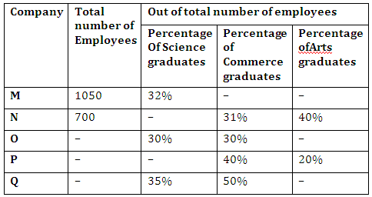
APTITUDE
DATA INTERPRETATION VIDEO-2
Directions (6-9): Study the table and answer the given questions.Data related to the number of employees in five different companies in December 2012
Note: (I) Employees of the given companies can be categorised only in three types: Science graduates, Commerce graduates and Arts graduates
(II) A few values are missing in the table (indicated –). A candidate is expected to calculate the missing value, if it is required to answer the given question, on the basis of the given data and information.

Slide 6
APTITUDE
DATA INTERPRETATION VIDEO-2
Q:6. What is the difference between the number of Arts graduate employees and Science graduate employees in Company N?
87 (b) 89 (c) 77 (d) 81 (e) 73
Q:7.The average number of Arts graduate employees and commerce graduate employees in Company Q was 312. What was the total number of employees in Company Q?
920 (b) 960 (c) 1120 (d) 1040 (e) 1080
Q:8.If the ratio of the number of Commerce graduate employees to that of Arts graduate employees in Company M was 10 : 7, what was the number of Arts graduate employees in M?
294 (b) 266 (c) 280 (d) 308 (e) 322
Q:9.The total number of employees in Company N increased by 20% from December 2012 to December 2013. If 20% of the total number of employees in Company N in December 2013 were Science graduates, what was the number of Science graduate employees in company N in December 2013?
(a) 224 (b) 266 (c) 294 (d) 252 (e) 168

Slide 7
APTITUDE
DATA INTERPRETATION VIDEO-2
Q:6. What is the difference between the number of Arts graduate employees and Science graduate employees in Company N?
87 (b) 89 (c) 77 (d) 81 (e) 73
Q:7.The average number of Arts graduate employees and commerce graduate employees in Company Q was 312. What was the total number of employees in Company Q?
920 (b) 960 (c) 1120 (d) 1040 (e) 1080
Q:8.If the ratio of the number of Commerce graduate employees to that of Arts graduate employees in Company M was 10 : 7, what was the number of Arts graduate employees in M?
294 (b) 266 (c) 280 (d) 308 (e) 322
Q:9.The total number of employees in Company N increased by 20% from December 2012 to December 2013. If 20% of the total number of employees in Company N in December 2013 were Science graduates, what was the number of Science graduate employees in company N in December 2013?
(a) 224 (b) 266 (c) 294 (d) 252 (e) 168

Slide 8
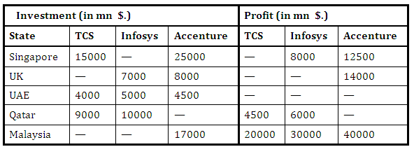
APTITUDE
DATA INTERPRETATION VIDEO-3
Directions (Q10 – 13): In the following table, the Investment and profit of three Companies in different countries is given.
Note: Some values are missing. You have to calculate these values as per data given in the questions: –

Slide 9
APTITUDE
DATA INTERPRETATION VIDEO-3
Q:10. If TCS invested his amount in SINGAPORE state for 9 years and Accenture invested his amount in the same country for 10 years then find the total profit made by all of them from SINGAPORE ?
mn $ 29250 (b) mn $ 24250 (c) mn $ 27250 (d) None of these
Q:11.If the total profit earned from UK by all of them is mn $ 32375. and each invested for 9 years then find the ratio of investment of TCS in UK to the profit of Infosys from SINGAPORE ?
16 : 7 (b) 7 : 16 (c) 8 : 13 (d) 13 : 8 (e) None of these
Q:12. If TCS, Infosys and Accenture invested in UAE for 5 years, 8 years and 6 years respectively then profit earned by Accenture from UAE is what % of the profit earned by TCS and Infosys together from the same Country, if total profit earned by all of them from UAE state is 8700 mn $.
45% (b) 50% (c) 55% (d) 40% (e) None of these
Q:13.In Malaysia state total Investment of TCS and Infosys is 85000 mn $, while TCS and Infosys invested their amount for 4 years and 6 years respectively in the same country, then find the number of years that accenture invested his amount ?
(a) 8 years (b) 9 years (c) 20 years (d) Can’t be determined (e) None of these

Slide 10
APTITUDE
DATA INTERPRETATION VIDEO-3
Q:10. If TCS invested his amount in SINGAPORE state for 9 years and Accenture invested his amount in the same country for 10 years then find the total profit made by all of them from SINGAPORE ?
mn $ 29250 (b) mn $ 24250 (c) mn $ 27250 (d) None of these
Q:11.If the total profit earned from UK by all of them is mn $ 32375. and each invested for 9 years then find the ratio of investment of TCS in UK to the profit of Infosys from SINGAPORE ?
16 : 7 (b) 7 : 16 (c) 8 : 13 (d) 13 : 8 (e) None of these
Q:12. If TCS, Infosys and Accenture invested in UAE for 5 years, 8 years and 6 years respectively then profit earned by Accenture from UAE is what % of the profit earned by TCS and Infosys together from the same Country, if total profit earned by all of them from UAE state is 8700 mn $.
45% (b) 50% (c) 55% (d) 40% (e) None of these
Q:13.In Malaysia state total Investment of TCS and Infosys is 85000 mn $, while TCS and Infosys invested their amount for 4 years and 6 years respectively in the same country, then find the number of years that accenture invested his amount ?
(a) 8 years (b) 9 years (c) 20 years (d) Can’t be determined (e) None of these

Slide 11
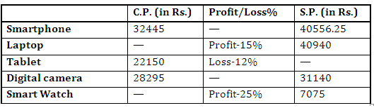
APTITUDE
DATA INTERPRETATION VIDEO-4
Directions (Q. 14-17): A person purchased 5 Gadgets from a shop and sold them online. Given below is the data showing cost price, selling price and profit/loss percentage.

Slide 12
APTITUDE
DATA INTERPRETATION VIDEO-4
Q:14. Cost price of Laptop is what percent of selling price of Tablet? (approximate)
138% (b) 182% (c) 142% (d) 154% (e) 186%
Q:15.If there has been a profit of 12% on Tablet instead of 12% loss. Then the new S.P. is how much more than the original S.P.?
5216 (b) 5396 (c) 5336 (d) 5316 (e) None of these
Q:16.Profit percentage on Digital camera is what percent more/less than profit percentage on Laptop?
50% more (b) 33.34% less (c) 33.67% more (d) 50% less(e) 150% less
Q:17.What is the ratio between profit percentage of Smart Watch to profit percentage of Smartphone?
(a) 5 : 3 (b) 3 : 2 (c) 3 : 5 (d) 2 : 5 (e) None of these

Slide 13
APTITUDE
DATA INTERPRETATION VIDEO-4
Q:14. Cost price of Laptop is what percent of selling price of Tablet? (approximate)
138% (b) 182% (c) 142% (d) 154% (e) 186%
Q:15.If there has been a profit of 12% on Tablet instead of 12% loss. Then the new S.P. is how much more than the original S.P.?
5216 (b) 5396 (c) 5336 (d) 5316 (e) None of these
Q:16.Profit percentage on Digital camera is what percent more/less than profit percentage on Laptop?
50% more (b) 33.34% less (c) 33.67% more (d) 50% less(e) 150% less
Q:17.What is the ratio between profit percentage of Smart Watch to profit percentage of Smartphone?
(a) 5 : 3 (b) 3 : 2 (c) 3 : 5 (d) 2 : 5 (e) None of these

Slide 14
APTITUDE
THANK YOU

